Slide 1


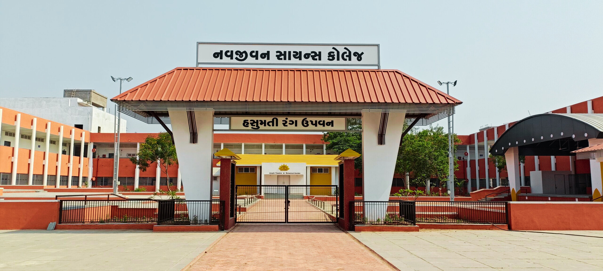



5th Feb., 2026
NATIONAL SEMINAR
ON EMERGING TRENDS IN BIO-CHEMICO SCIENCE
SPONSERED BY,
KNOWLEDGE CONSORTIUM OF GUJARAT (KCG),
PROMOTION OF RESEARCH AND
FACILITIES SCHEME OF
EDUCATION DEPARTMENT
Organized by
Navjivan Science College, Dahod
CONDUCTED BY
DAHOD ANAJ MAHAJAN SARVAJANIK EDUCATION SOCIETY
Venue-Navjivan Convention Centre
Girdharlal college campus, Zalod Road, Dahod, Gujarat

Slide 2
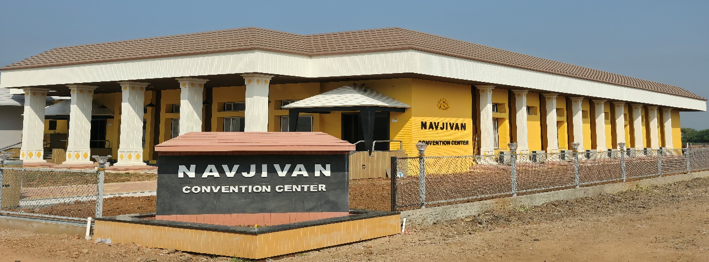
ABOUT THE INSTITUITION
Navjivan Science College was established on June 15th, 1973, by the visionary philanthropist Late Shri Girdharlal C. Sheth, under the auspices of the Dahod Anaj Mahajan Sarvajanik Education Society (DAMSES). As a prestigious science institute in the rural heart of Dahod, our primary objective is to provide high-quality education to youth from tribal and underprivileged backgrounds at an affordable cost. Spanning a lush 6.5-acre green campus, the college offers well-equipped laboratories and is supported by expert faculty dedicated to the academic and social upliftment of our students
ABOUT THE SEMINAR
The National Seminar on Emerging Trends in Bio-Chemico Science (NSBCS-2026) is a premier one-day scientific gathering organized by Navjivan Science College, Dahod, in collaboration with the Knowledge Consortium of Gujarat (KCG). This seminar aims to bridge the gap between fundamental research and modern applications by bringing together students, researchers, and academicians on a common platform. By focusing on the dynamic intersection of Chemical and Biological sciences, NSBCS-2026 seeks to foster scientific inquiry, encourage interdisciplinary research, and highlight the latest innovations shaping our future.
ABOUT THE VENUE
The seminar will be held at the Navjivan Convention Centre, located within the Shree Girdharlal College Campus on Zalod Road, Dahod. Featuring advanced AV technology, acoustic soundproofing, and a 400-seat capacity, the venue provides a world-class environment for national-level networking and research presentation.

Slide 3
THE CONFERENCE TRACK WILL ENCOMPASS A WIDE RANGE OF TOPICS WITHIN CHEMICAL AND BIOLOGICAL SCIENCES, INCLUDING:
  Organic & Inorganic Chemistry.
  Analytical Techniques In Chemical & Biological Sciences.
  Environmental Science & Sustainability.
  Plant Sciences, Animal Sciences & Microbiology.
  Nanotechnology & Nano Materials In Biomedical Applications.
  Computational & In-silico Studies.
  Bioinformatics.
  Wildlife Studies.
  Physio-chemical Approaches.
  Biochemistry & Molecular Biology.
  Medicinal Chemistry & Drug Discovery.
  Biotechnology & Genetic Engineering.
  Synthetic Biology & Bio Molecular Engineering.
  Fluorescence Study & It’s Applications.
  Intellectual Property Rights: Prospects & Challenges
  Applied Life Sciences

Slide 4


Call for Abstract (Poster Presentation)
Participants are invited to submit abstracts of their unpublished research work (maximum 300 words & 06 keywords) that should be written in Times New Roman font, double line spacing with Times New Roman 12 font size using Microsoft word.
Presenting authors must be highlighted by asterisk (*) with complete mailing address.
Email your abstract on nsbcs2026@gmail.com on or before 26/01/2026.
Guidelines for Poster Presentation
Participants are requested to prepare their posters that should not exceed the dimension 90cm x 120cm (width x length).
Poster should be furnished with the title, authors name, affiliation, introduction, material and methods, results and discussion, conclusion and references. Clear pictures, diagrams, graphs and short tables are highly encouraged to use in posters to win the best poster prize in chemical sciences and biological
sciences.
The presenting author is entitled for the poster presentation certificate.
IMPORTANT DATES
Registration & Abstract Submission Opens On | 11th December 2025
Registration & Abstract Submission Closes On | 26th January 2026
Confirmation OF Acceptance | 26th January 2026
NOTE: Conference registration fee is non-refundable and non transferable.

Slide 5
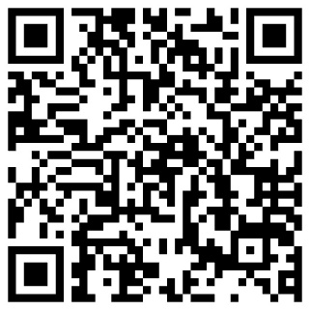
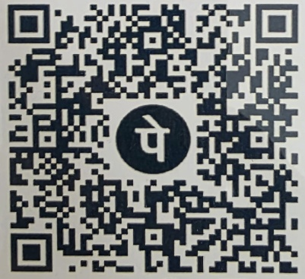
REGISTRATION FEE DETAILS
CATEGORIES | INCLUDING REGISTRATION AND ALL MEALS
STUDENTS (UG&PG) | ₹300
RESEARCH SCHOLAR AND POST DOCTORATE | ₹500
FACULTY AND SCIENTISTS | ₹700
INDUSTRIAL PERSON/OTHERS | ₹1000
FOR REGISTRATION
https://forms.gle/e5NqWRW9vmtg4id76
CLICK THE LINK OR SCAN THE QR CODE TO SUBMIT YOUR DETAILS.
PAYMENT DETAILS
NAME OF ACCOUNT: NAVJIVAN SCIENCE COLLEGE A C P G
NAME OF THE BANK: THE DAHOD URBAN CO.OP. BANK LTD: DAHOD
BANK ADDRESS : SETH SHRI GIRDHARLAL SHAHKAR
BHAVAN, APMC COMPOUND, MARKET YARD, DAHOD
TYPE OF ACCOUNT : SAVING
ACCOUNT NUMBER : 80800250112089292
IFSC CODE: HDFC0CDUCBE
UPI ID: navjivanscience1@ibl
MO..: +919484548232
FOR ANY FURTHER QUERIES AND ASSISTANCE, PLEASE CONTACT:
Mr. DIXIT RATHVA
MO:+917567764429
Mr. NEEL PATEL
MO:+9199042 04767

Slide 6
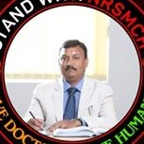
CHIEF PATRON
Prof. Dr. SANJAY KUMAR
CHIEF EXECUTIVE OFFICER
ZYDUS MEDICAL COLLEGE AND HOSPITAL
GUEST SPEAKERS
Dr. SURESHKUMAR KAILASHA
SVNIT, SURAT
Dr. MEHUL P. DAVE
IITE, GANDHINAGAR
PATRON
Dr. G.J KHARADI
I/C PRINCIPAL
Mr. MIHIR SHAH
DIRECTOR
ORGANIZING CHAIRMAN
Mr. S. S. PRAJAPATI
CONVENER
Dr. H. R.DABHI
CO- CONVENER
MEMBERS OF ORGANIZING COMMITTEE
  Smt. N.A.VOHRA
  Dr. K. J. MEHTA
  Dr. V. J CHAUHAN
  Dr. N. M. VAGHELA
  Mr. P. C. PAWAR
  Dr. R. R. PATEL
  Dr. V. R. JAIN.
  Dr. S. A. PATEL
  Dr. K. T. JOSHI
  Mr. N. R. PATEL
  Mr. D. D. RATHVA
  Mr. K. B. PATEL
  Mr. H. G. SOLANKI
  Mr. A. N. CHAUHAN
  Ms. S. P. MODHIYA
  Ms. S. C. KHAPED
  Ms. B. J. TILWANI
  Ms. K. K. PARMAR
  Ms. A. S. BHABHOR
  Ms. D. K. PATEL
  Ms. P. R. SANGADA
  Ms. S. A. PATHAN
  Ms. P. V. MACWAN

Slide 7
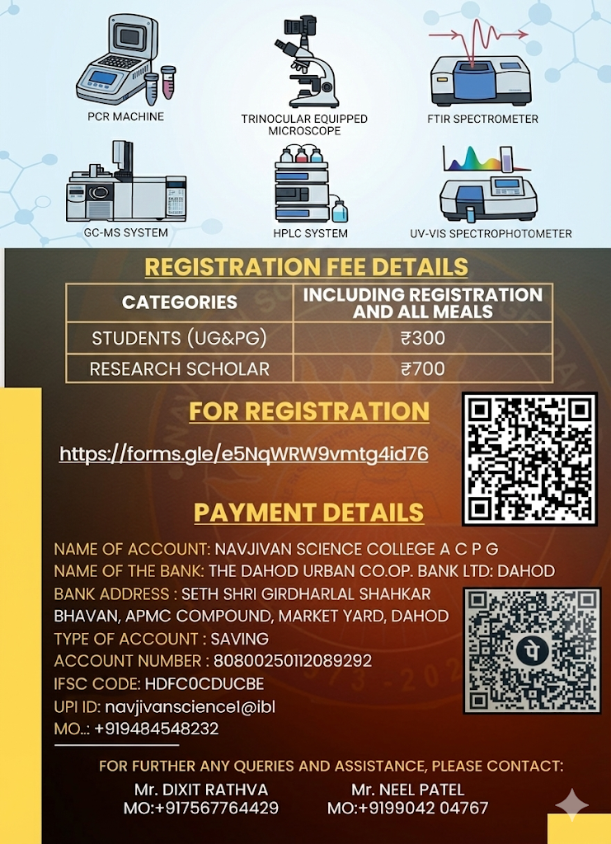
NATIONAL ADVISORY COMMITEE
Dr. Samat Ram, Kapadvanj
Dr. Nilesh Pandya, Surat
Dr. Brijesh Shukla, Surat
Dr. Ramakant Pandya ,Godhra
Dr. Anirudh Desai, Balasinor
Dr. Sailesh Prajapati, Lunawada
Dr. Priyanka Trivedi, Godhra
Prof. Astha Bariya, Zalod
Prof. M. P. Gor, Bhadaran
Dr. D. A. Odedara, Gandhinaar
Dr. C. C. Pathak, Gandhinagar
Dr. D. K. Rana, Rajpipla
Dr. Nikunj Bhatt , Anand
Dr. Pragnesh Patel, Limkheda
Dr. Aarati Raval, Surat
Dr. Ujjaval Trivedi, Anand
Dr. Savitaben Dixit, Bhopal
Dr. H. D. Patel, Ahmedabad
Dr. Hitesh Solanki, Ahmedabad
Dr. S. Bhattacharya, Maharashtra
Dr. Ashish Vakulkar, Maharashtra
Dr. Jigar Soni, Rajhasthan
Dr. Rakshit Ameta ,Udaipur
Dr. O. S. Kotivar, Maharashtra
Dr. K. D. Patel, Vidhyanagar
Dr. Bharat Dholakiya, Surat
Dr. K. D. Patel, V V Nagar
Dr. Rupesh Nakar, Godhra
Dr. Jignesh Raval, Godhra
Dr. Dimple Damore, Ahmedabad
Dr. Mukesh Chauhan, Godhra
Dr. Prasanna Dharani, Godhra
Upcoming Advanced Instrumentation Facility
SPONSOR

Slide 8

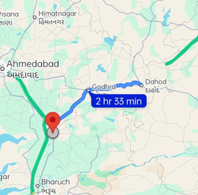
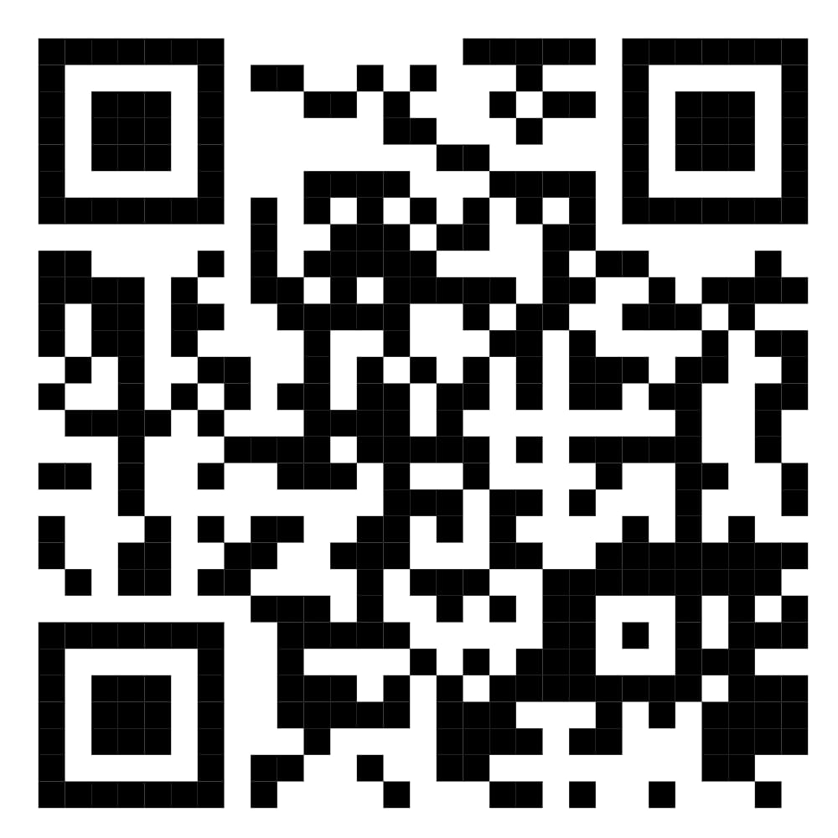
Your paragraph text
How to reach Dahod
It is 140km from Vadodara which is connected by Railways as well as through regular, bus services. Ahmedabad is 197 km away from Dahod. itself Dahod has railway station facility along with good facilities of local transport to connect with all centers.

